Slide 1

Applied AI using Cognitive Services
Hands-on Tutorial
@GaliyaWarrier

Slide 2

About me
ENTERPRISE,
Data,
Solutions,
Architecture,
Azure
galiyawarrier

Slide 3
The Microsoft AI platform: Azure+AI Cloud-powered AI for every developer
Services
CONVERSATIONAL AI
TRAINED SERVICES
CUSTOM SERVICES
CODING & MANAGEMENT TOOLS
Bot Framework
Tools
Cognitive Services
Azure Machine Learning
VS Tools for AI
Azure ML Studio
Azure ML Workbench
Others (PyCharm, Jupyter Notebooks…)
Infrastructure
DEEP LEARNING FRAMEWORKS
AI ON DATA
AI COMPUTE
3rd Party
Cosmos DB
SQL
DB
SQL
DW
Data Lake
Spark
DSVM
Batch AI
ACS
Edge
Cognitive Toolkit
TensorFlow
Caffe
CPU, FPGA, GPU
Others (Scikit-learn, MXNet, Keras, Chainer, Gluon…)

Slide 4

Cognitive Services
Vision
Speech
Language
Knowledge
Search
Labs
From faces to feelings, allow your apps to understand images and video
Hear and speak to your users by filtering noise, identifying speakers, and understanding intent
Process text and learn how to recognize what users want
Tap into rich knowledge amassed from the web, academia, or your own data
Access billions of web pages, images, videos, and news with the power of Bing APIs
Emerging Cognitive Services technologies for early adopters
Custom
Custom
Custom
Custom
Custom
Vision Service
Speech Service
Language Understanding
Decision Service
Search

Slide 5
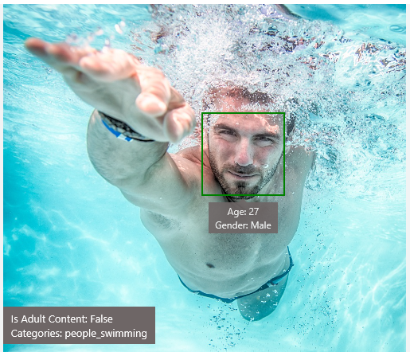
Analyse Image
https://azure.microsoft.com/en-gb/services/cognitive-services/computer-vision/
Type of image
Clip Art Type 0 Non-clipart
Line Drawing Type 0 Non-Line Drawing
Black & White Image False
Content of image
Categories [{ “name”: “people_swimming”, “score”: 0.099609375 }]
Adult Content False
Adult Score 0.18533889949321747
Faces [{ “age”: 27, “gender”: “Male”, “faceRectangle”: {“left”: 472, “top”: 258, “width”: 199, “height”: 199}}]
Image colors
Dominant Color Background White
Dominant Color Foreground Grey
Dominant Colors White
Accent Color

Slide 6
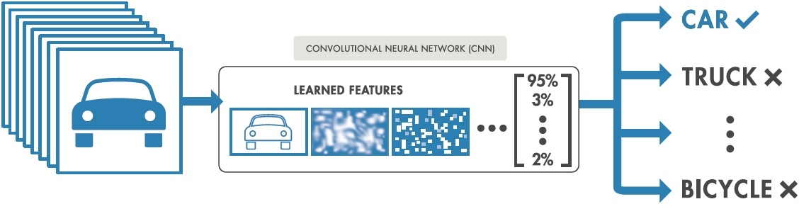
Deep learning networks for image classification

Slide 7
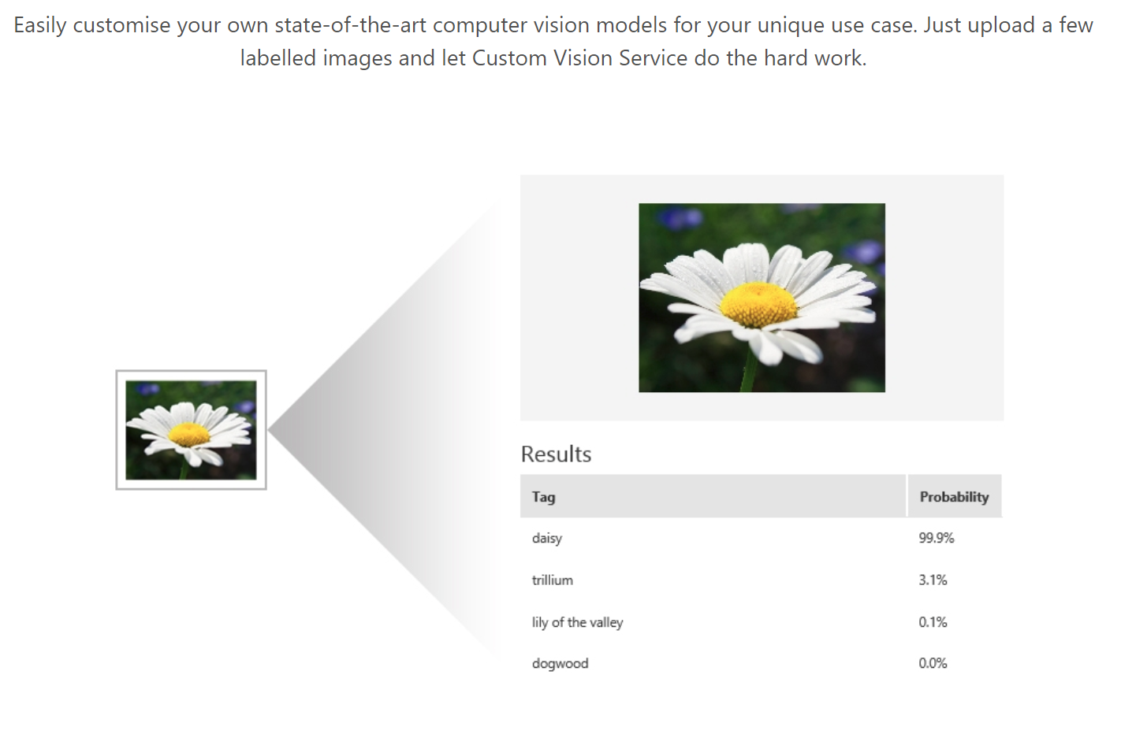
Custom Vision Service
https://customvision.ai

Slide 8
Tutorial: Links and resources
https://github.com/galiya/TechKnow2018Workshop
- Size: 12 Mb
Estimated time:
- Part 1 – Build, Train and Test your Custom Image Classifier [40 min]
- Part 2 – Use applications to recognise images:
Console app (10 min)
Web application (20 min)
iOS application (20 min)

